Slide 1

Bye Bye Bicycle
Sebastiaan Giebels, Willem van Heemstra &
Vera van Otterdijk @ Science Hack Day 2018

Slide 2
Problem
Bike theft is low profile crime
Big impact on people living on a small budget
Effort finding stolen bikes outweighs gain
Therefore it is not a priority with the police
Increases perceived level of crime

Slide 3
Problem
The problem in numbers:
In 2015 almost 3000 bicycle thefts reported in Eindhoven
Only 30% of bike thefts reported
Police can only file reports when all information is known
(brand, model, serial/frame number, color)
No statistics found on number of bikes returned by the police

Slide 4

Why
Parking a bicycle in Eindhoven should not fill you with fear of theft
It is stupid that existing registration and identification systems cannot be used effectively

Slide 5


How
Use existing serial number and barcode system
Get citizens involved in helping the police
Minimize effort for police

Slide 6
What
Registering:
Help people to take note of their unique bicycle data
This is required by police when reporting bike theft
Send this data by e-mail, so people can keep it
Do not save the data to safeguard owner privacy

Slide 7

What
Reporting:
Bye Bye Bicycle app as extension to Trillion
Citizens are challenged to scan bicycles
The app runs the scanned serial numbers through the stolen bicycles registry (FDR.RDW.nl)
Stolen bikes are reported through the Trillion platform
The police can effectively go after stolen bikes
And identify “hotspots” for finding stolen bikes

Slide 8


Slide 9
Prototypes
App:
Query stolen bikes registry (FDR.RDW.nl) automatically through app
Get immediate feedback if bike is stolen or not

Slide 10

Prototypes
Hardware:
Scanning barcodes on bicycles
Scanning RFID tags in bicycles (fiets chip)

Slide 11

Recommendations
Stimulate citizens of Eindhoven to take note of their bike data (provide forms)
Closer cooperation with stolen bikes registry (Fietsdiefstalregister) to improve API
Enable volunteers to help fight this problem by scanning bikes
Subsidizing/placement of a bike registration station in 18 September Plein bike parking

Slide 12
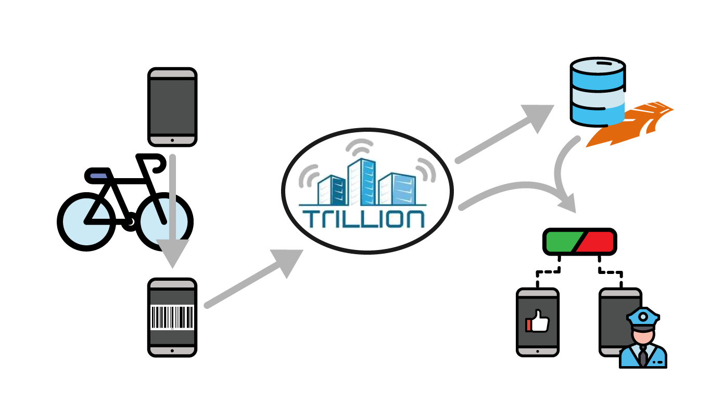
Questions?

